Slide 1

NYCT Bus Analysis Project
Optimizing Urban Transit with IoT and Advanced Data Analytics
Daniel Premysler
Notes:
This presentation was automatically generated by PowerPoint Copilot based on content found in this document: https://pointer2-my.sharepoint.com/personal/danielp_pointer4u_co_il/Documents/project_bus_fleet.docx AI-generated content may be incorrect.

Slide 2
Agenda
Introduction and Project goals
Solution Architecture
Source
Data Ingestion
Storage
Transformation and Data Modeling
Orchestration
Demo
Notes:
Agenda * Overview * Introduction * Solution Architecture * Source * Data Ingestion * Storage * Transformation and Data Modeling * Orchestration * Serving * CI/CD * Instructions / Getting started * Infrastructure * Setting up Airbyte * Get GTFS data * Test the pipeline * Deploy the pipeline * Notes on Security

Slide 3

Introduction and Project goals
Real-Time Data Integration: Merge live bus data (REST Api) with GTFS
Trip Reconstruction: Rebuild trips using combined datasets
Pipeline Development: Develop efficient, scalable data pipeline, hosted on the cloud
CI/CD Implementation: Streamline secure deployment and updates.
Business Questions: Answer key business questions using comprehensive data analysis.
Notes:
The project aims to analyze NYC MTA bus route performance by collecting real-time data from IoT devices and combining it with GTFS data. Key objectives include data collection, trip creation, performance analysis, and dashboard visualization. Questions to answer include identifying delayed and overcrowded routes, and determining the best times for bus availability. Original Content: Introduction The objective of this project is to create a robust data pipeline that will enable the analysis of NYC MTA bus route performance. This will be achieved by simulating an IoT company that installs IoT devices on MTA buses to collect data. The project involves mining data from these IoT devices and integrating it with static data from GTFS (General Transit Feed Specification) provided by the MTA, which includes information on agency, calendar, calendar_dates, routes, shapes, stop_times, and trips. The primary goal is to gather real-time bus location data from an API, which provides updates every 15 seconds. This data, combined with the GTFS data, will be used to construct detailed trip records. Key objectives include: 1. Data Collection: Extract real-time bus location data and combine it with static GTFS data. 2. Trip Creation: Develop a method to create detailed trip records using the continuous data stream and GTFS data. 3. Performance Analysis: Analyze the gathered data to measure bus route crowding and identify routes with significant delays. 4. Dashboard Visualization: Implement a PowerBI dashboard to visualize analytics and provide actionable insights. Questions we want to answer include: • Which bus routes delay the most? • Which bus routes are overcrowded? • At what times routes are mostly delayed? • At what times the routes are mostly overcrowded? • Which bus routes have the best availability?

Slide 4
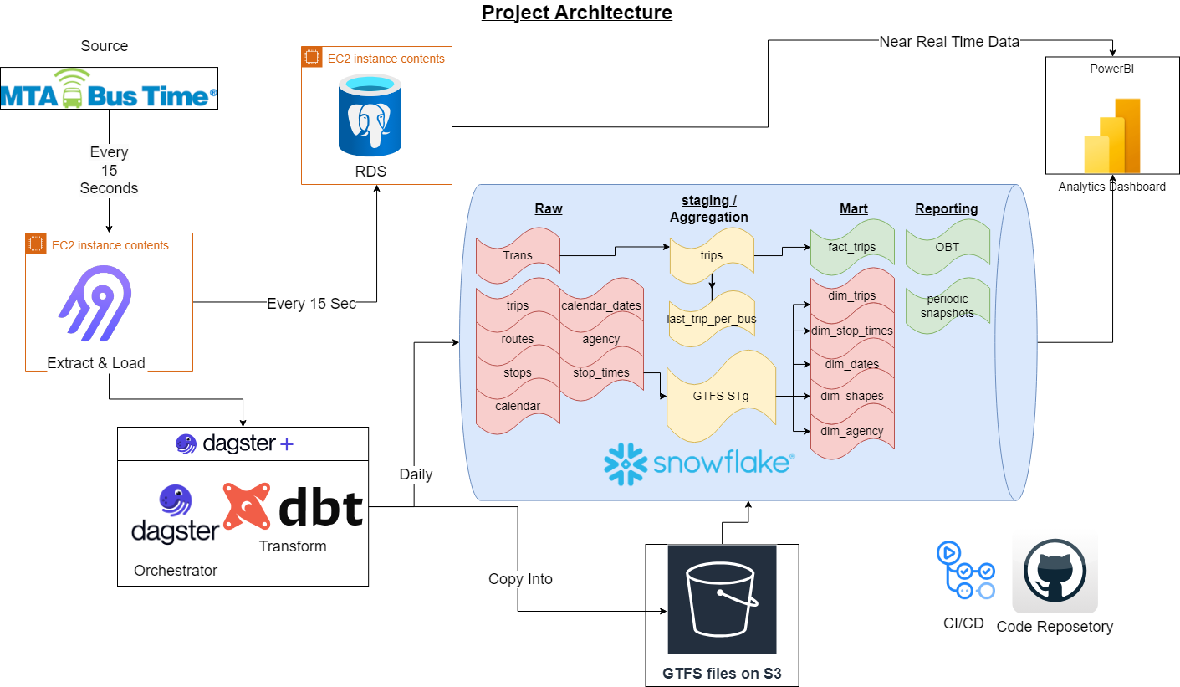
Notes:
This slide presents the solution architecture, as illustrated in Figure 1. Original Content: Solution Architecture docs/images/project_architecture.png Figure 1: Solution architecture

Slide 5

Sources
MTA Real Bus Time API
Provides real-time bus location data
Updates every 15 seconds
MTA GTFS Static Data
Includes information on agency, calendar, routes, shapes, stop times, trips, and stops
Describes bus scheduling in New York City
Static data
Visual representation of GTFS data relationship
Notes:
The MTA uses two main data sources: the Real Bus Time API for real-time bus locations and GTFS static data for bus schedules. The GTFS data includes various elements like routes and stops. More details can be found on Google Transit and MTA Developer resources. Original Content: Source The source includes the MTA real Bus Time API, which provides real-time bus location data. The API is documented here. The second source is the MTA GTFS static data, which includes information on: • Agency • Calendar • Calendar_dates • Routes • Shapes • Stop_times • Trips • Stops This data describes the scheduling of buses in New York City. The GTFS entity relationship diagram is shown below. docs/images/GTFS-entity-relationship-diagram.png Figure 2: GTFS Entity Relationship Diagram More information about GTFS data sets can be found at: Google Transit MTA Developer resources

Slide 6
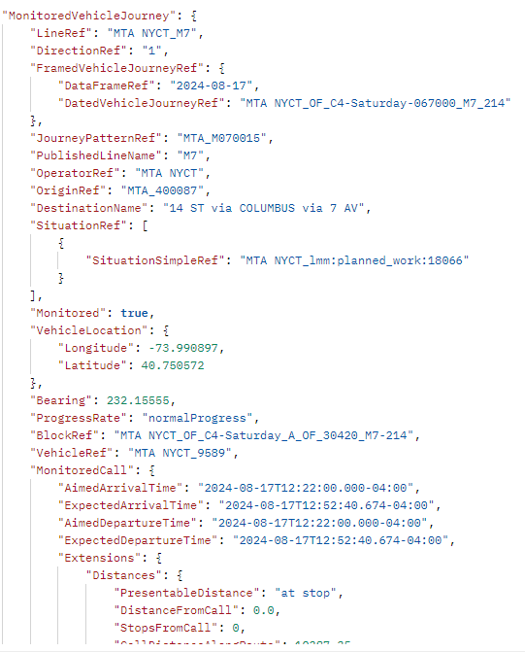
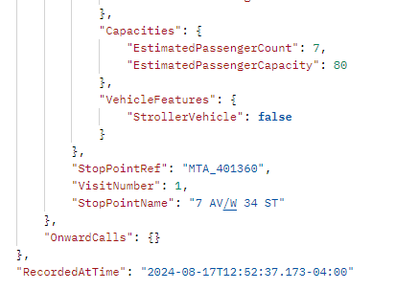
Sources
Sources
MTA Real Bus Time API
Provides real-time bus location data
Updates every 15 seconds
MTA GTFS Static Data
Includes information on agency, calendar, routes, shapes, stop times, trips, and stops
Describes bus scheduling in New York City
Static data
Visual representation of GTFS data relationship
Notes:
The MTA uses two main data sources: the Real Bus Time API for real-time bus locations and GTFS static data for bus schedules. The GTFS data includes various elements like routes and stops. More details can be found on Google Transit and MTA Developer resources. Original Content: Source The source includes the MTA real Bus Time API, which provides real-time bus location data. The API is documented here. The second source is the MTA GTFS static data, which includes information on: • Agency • Calendar • Calendar_dates • Routes • Shapes • Stop_times • Trips • Stops This data describes the scheduling of buses in New York City. The GTFS entity relationship diagram is shown below. docs/images/GTFS-entity-relationship-diagram.png Figure 2: GTFS Entity Relationship Diagram More information about GTFS data sets can be found at: Google Transit MTA Developer resources

Slide 7
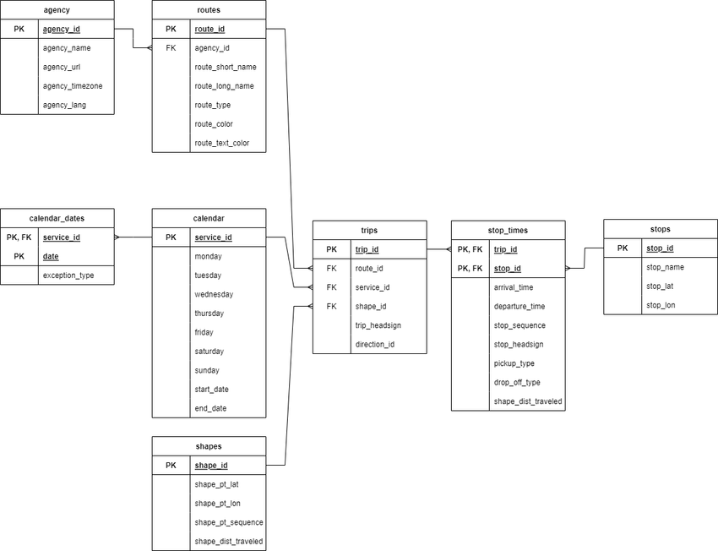
Sources
Sources
MTA Real Bus Time API
Provides real-time bus location data
Updates every 15 seconds
MTA GTFS Static Data
Includes information on agency, calendar, routes, shapes, stop times, trips, and stops
Describes bus scheduling in New York City
Static data
Visual representation of GTFS data relationship
Notes:
The MTA uses two main data sources: the Real Bus Time API for real-time bus locations and GTFS static data for bus schedules. The GTFS data includes various elements like routes and stops. More details can be found on Google Transit and MTA Developer resources. Original Content: Source The source includes the MTA real Bus Time API, which provides real-time bus location data. The API is documented here. The second source is the MTA GTFS static data, which includes information on: • Agency • Calendar • Calendar_dates • Routes • Shapes • Stop_times • Trips • Stops This data describes the scheduling of buses in New York City. The GTFS entity relationship diagram is shown below. docs/images/GTFS-entity-relationship-diagram.png Figure 2: GTFS Entity Relationship Diagram More information about GTFS data sets can be found at: Google Transit MTA Developer resources

Slide 8
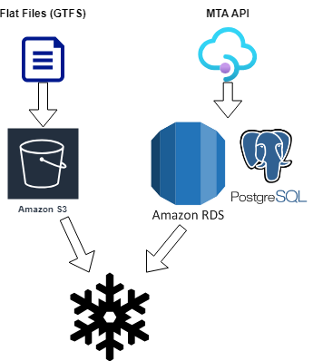
Data Ingestion
Data Ingestion with Airbyte
Hosted on Amazon EC2 instance, whitelist specific IP’s
Extracts data from MTA real Bus Time API using custom connector
Incremental load method, into Postgres RDS to avoid expensive ingestion into Snowflake
Custom Connector for API
Securely passes API key
Allows controlling size of data
Data Movement to Snowflake
Daily transfer from PostgreSQL to Snowflake using Dagster
Loading GTFS Files
Hosted on S3 bucket
Ingested using Snowflake’s COPY INTO method
Efficiently handles large files
Notes:
We use Airbyte on an Amazon EC2 instance to ingest data from the MTA real Bus Time API every 15 seconds. A custom connector securely passes the API key. Data is moved daily from PostgreSQL to Snowflake using Dagster. GTFS files are loaded from an S3 bucket using Snowflake’s COPY INTO method. Original Content: Data Ingestion We ingest the data from the MTA real Bus Time API using Airbyte. Airbyte is hosted on an Amazon EC2 instance. It is responsible for data extraction and connection between the PostgreSQL database and the MTA real Bus Time API. It runs every 15 seconds using a cron expression. In order to connect to the API, a custom connector was created to pass an API key securely. MTA Custom Connector docs/images/airbyte_on_cloud.png Figure 3: Airbyte on cloud We also use Airbyte to move the data from the PostgreSQL database to Snowflake warehouse daily using Dagster. To load the GTFS files, we are hosting them on an S3 bucket and using Snowflake’s COPY INTO method to ingest the data quickly and efficiently. We have some large GTFS files; Stop_times has almost 1 million rows. Loading all the GTFS files using dbt seed would take more than 15 minutes. Loading it using COPY INTO takes less than 10 seconds. docs/images/airbyte_on_cloud.png Figure 4: Airbyte ingestion

Slide 9



Storage
Snowflake as Main Storage
Scalability: Easily handles large data volumes
Performance: Excellent query performance with columnar storage and MPP engine
Efficient data loading: Quick loading with COPY INTO method
Built-in features: Time travel and data sharing for analysis and collaboration
Integration with BI tools: Works well with many BI vendors
PostgreSQL for Raw Transit Data
Cost-effective buffer: Avoids high costs of frequent Snowflake queries
Near real-time reporting: Immediate insights into bus locations
Data staging: Allows for initial data quality checks and preprocessing
Notes:
We use Snowflake for its scalability, performance, and integration capabilities. PostgreSQL serves as a cost-effective buffer for raw transit data, enabling near real-time reporting and flexible querying. Original Content: Storage We use snowflake as the main storage for the project. for several reasons: 1. Scalability: Snowflake’s cloud-based architecture allows for easy scaling to handle large volumes of data from both the real-time bus location API and the GTFS static data. 2. Performance: Snowflake’s columnar storage and MPP (Massively Parallel Processing) engine provide excellent query performance, which is crucial for analyzing the large datasets involved in this project. 3. Data integration: Snowflake makes it easy to integrate data from multiple sources, including the PostgreSQL database holding the raw transit data and the GTFS files stored in S3. 4. Efficient data loading: As mentioned in the ingestion data part, using Snowflake’s COPY INTO method allows for quick and efficient loading of large GTFS files, significantly reducing ingestion time compared to other methods. 5. Separation of storage and compute: Snowflake’s architecture allows you to scale storage and compute resources independently, optimizing costs and performance. 6. Built-in features: Snowflake provides features like time travel and data sharing, which can be valuable for data analysis and collaboration in this project. 7. Integration with BI tools: Snowflake integrates well with visualization tools like PowerBI, facilitating the creation of dashboards for route performance analysis. We store the raw trans data on postgres hosted on AWS, there are several benefits we explore with this solution: 1. Cost-effective buffer: Loading data directly from Airbyte into Snowflake frequently (every 15 seconds) would be prohibitively expensive due to Snowflake’s consumption-based pricing model. PostgreSQL serves as a cost-effective buffer for the raw transit data. 2. Near real-time reporting: The raw transit data stored in PostgreSQL can be used to generate near real-time location reports. This allows for immediate insights into bus locations without incurring the costs associated with frequent Snowflake queries. 3. Data staging: PostgreSQL acts as an excellent staging area for the raw transit data before it’s transferred to Snowflake. This staging step allows for initial data quality checks and potential preprocessing. 4. Flexible querying: PostgreSQL’s powerful querying capabilities enable quick analysis of the most recent data without impacting the main data warehouse operations in Snowflake. 5. Reduced Snowflake ingestion frequency: By using PostgreSQL, we can aggregate data over time and perform less frequent, batch transfers to Snowflake (e.g., daily), significantly reducing data ingestion costs.

Slide 10
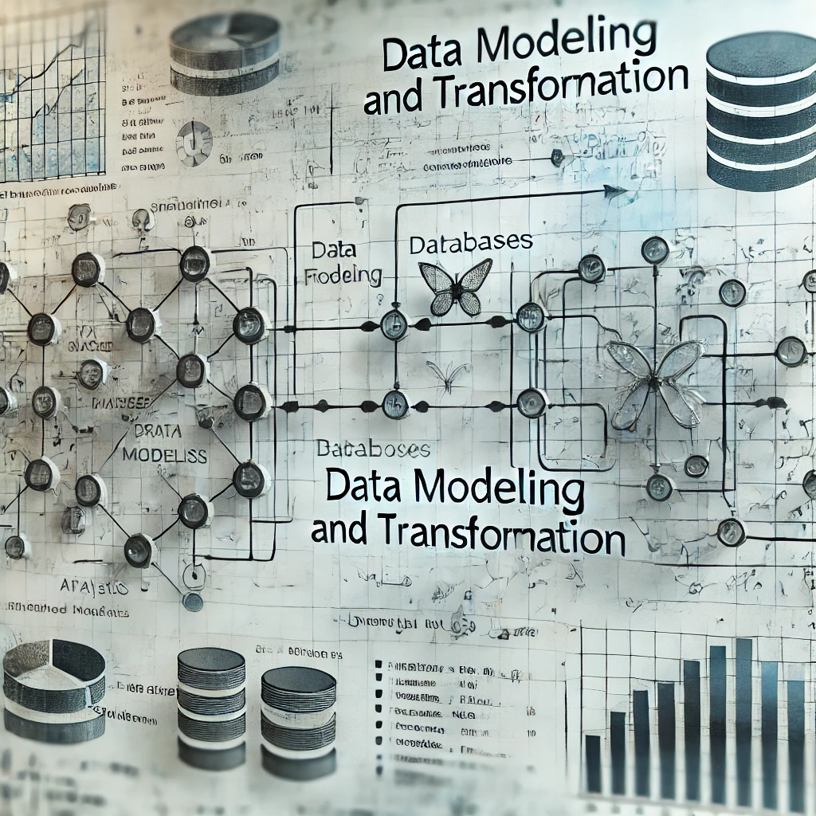
Transformation and Data Modeling
Data modeling with dbt
Field rename
Data type casting
Case statements
Concatenation
Date formatting
Data aggregation
Enrichment with GTFS data
Trip identification
Data Quality Checks with great expectations for dbt
Notes:
The transformation process involves field renaming, data type casting, and more. Trans data is converted into trips through aggregation, enrichment, and validation. Data quality checks ensure integrity, and the marts schema is created with additional transformations. Original Content: Transformation and Data Modeling The data loaded from Airbyte and S3 into Snowflake forms the raw schema. This data is then read and undergoes various transformations before forming the staging schema: • Field rename • Data type casting • case statements • concatenation • date formatting Converting trans data into trips The process of converting the trans data into trips involves several key steps: 1. Data aggregation: The raw transit data from trans.sql is aggregated to create meaningful trip records. This likely involves grouping the data by vehicle, route, and time periods to identify distinct trips. 2. Enrichment with GTFS data: The aggregated transit data is combined with static GTFS data (routes, stops, schedules) to add context and additional information to each trip. 3. Trip identification: Algorithms are applied to determine the start and end of each trip, possibly using factors like time thresholds, route changes, or specific stop patterns. 4. Calculation of metrics: Various performance metrics are calculated for each trip, such as actual travel time, scheduled travel time, delays, and potentially crowding information. 5. Data cleaning and validation: The process includes steps to clean the data, handle anomalies, and ensure the quality and consistency of the trip records. 6 Incremental approach: Post creation of trips a post hook is triggered to create a table with the latest trip date per each vehicle. Ensuring the next run would continute per each vehicle from the latest trans data available. Meaning even if a bus havent sent new data for days the incremental process would try to continue searching for new data. This transformation process takes the granular, real-time data and converts it into a higher-level, trip-based format, that’s more suitable for route performance analysis and reporting. Before the data is loaded into the staging schema, data quality checks were performed using Great Expectations and dbt tests, ensuring that: • Primary keys and foreign keys are not null • Referential integrity between related tables • Accepted value tests, confirming that certain columns only contain predefined acceptable values • validating relationships between different models Lastly, the marts schema is created performing additional transformations such as joins, aggregations,calculations, and surrogate keys. The marts schema can be represented by the following Entity Relationship Diagram (ERD): docs/images/ERD.png Figure 5: Marts - Entity Relationship Diagram (ERD)

Slide 11
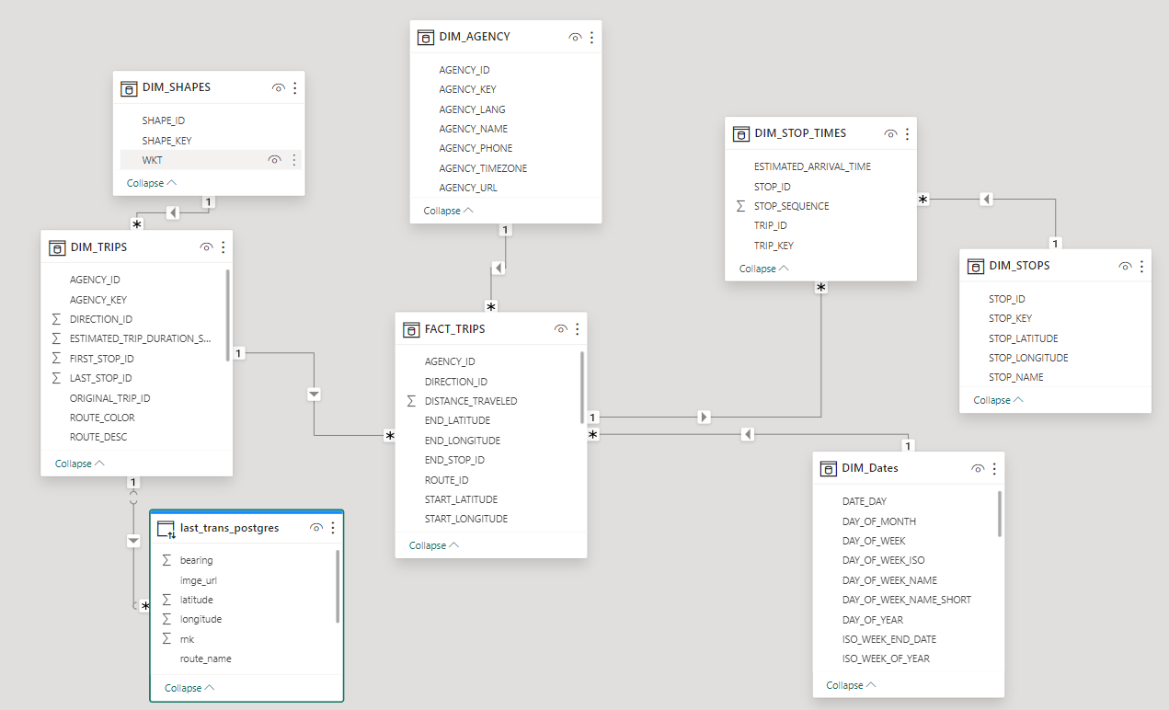
Data modeling ERD
Notes:
The transformation process involves field renaming, data type casting, and more. Trans data is converted into trips through aggregation, enrichment, and validation. Data quality checks ensure integrity, and the marts schema is created with additional transformations. Original Content: Transformation and Data Modeling The data loaded from Airbyte and S3 into Snowflake forms the raw schema. This data is then read and undergoes various transformations before forming the staging schema: • Field rename • Data type casting • case statements • concatenation • date formatting Converting trans data into trips The process of converting the trans data into trips involves several key steps: 1. Data aggregation: The raw transit data from trans.sql is aggregated to create meaningful trip records. This likely involves grouping the data by vehicle, route, and time periods to identify distinct trips. 2. Enrichment with GTFS data: The aggregated transit data is combined with static GTFS data (routes, stops, schedules) to add context and additional information to each trip. 3. Trip identification: Algorithms are applied to determine the start and end of each trip, possibly using factors like time thresholds, route changes, or specific stop patterns. 4. Calculation of metrics: Various performance metrics are calculated for each trip, such as actual travel time, scheduled travel time, delays, and potentially crowding information. 5. Data cleaning and validation: The process includes steps to clean the data, handle anomalies, and ensure the quality and consistency of the trip records. 6 Incremental approach: Post creation of trips a post hook is triggered to create a table with the latest trip date per each vehicle. Ensuring the next run would continute per each vehicle from the latest trans data available. Meaning even if a bus havent sent new data for days the incremental process would try to continue searching for new data. This transformation process takes the granular, real-time data and converts it into a higher-level, trip-based format, that’s more suitable for route performance analysis and reporting. Before the data is loaded into the staging schema, data quality checks were performed using Great Expectations and dbt tests, ensuring that: • Primary keys and foreign keys are not null • Referential integrity between related tables • Accepted value tests, confirming that certain columns only contain predefined acceptable values • validating relationships between different models Lastly, the marts schema is created performing additional transformations such as joins, aggregations,calculations, and surrogate keys. The marts schema can be represented by the following Entity Relationship Diagram (ERD): docs/images/ERD.png Figure 5: Marts - Entity Relationship Diagram (ERD)

Slide 12

Orchestration
Dagster as Orchestration Tool
Deployed using Dagster Cloud
CD with separate brunch deployment and prod deployement
Asset-based orchestration approach
Considered Materialization Approaches
Dagster Asset Job
Dagster Auto-materialize assets
Chosen Approach – Asset job
More flexible and customizable
Battle tested
Dagster Responsibilities
Calling Airbyte connection
Executing Snowflake COPY INTO
Notes:
Dagster was used for orchestration, deployed via Dagster Cloud. We considered Dagster Asset Job and Auto-materialize assets, choosing the former for its flexibility. Dagster handles Airbyte connections, Snowflake COPY INTO, and dbt workflows. Original Content: Orchestration Dagster was the orchestration tool used in this project and it was deployed using Dagster Cloud. Unlike other orchestration tools such as Airflow and Prefect, Dagster introduces an asset-based orchestration approach. As with many Data Engineering projects, there are many ways to orchestrate the data pipeline. More specifically, 3 different approaches were considered: 1. Dagster Asset Job: Create an Airbyte asset and a Databricks custom asset. These two assets would be selected to form an asset job that would be scheduled to run by Dagster 2. Dagster Auto-materialize assets: Create an Airbyte asset and a Databricks custom asset. Define and attach auto-materialize policies on these assets. Dagster will automatically materialize these assets when the specified criteria are met In this project, we use asset job to materialize the assets rather then Auto-materialize policy. We did it because it is a more flexible approach, allowing us to customize the execution logic and implement complex transformations steps that my not be possible with auto materialize. In this approach, Dagster is responsible for calling the Airbyte connection along with Snowflake COPY INTO and then the dbt workflow illustrated below. The Dagster Global Asset Lineage looks as follow: docs/images/dagster_asset_lineage.png Figure 6: Dagster Global Asset Lineage Asset job run on the cloud: docs/images/dagster_running_on_cloud.png Figure 7: Dagster asset job Scheduled runs: docs/images/dagster_runs.png Figure 8: Dagster asset job scheduled runs

Slide 13
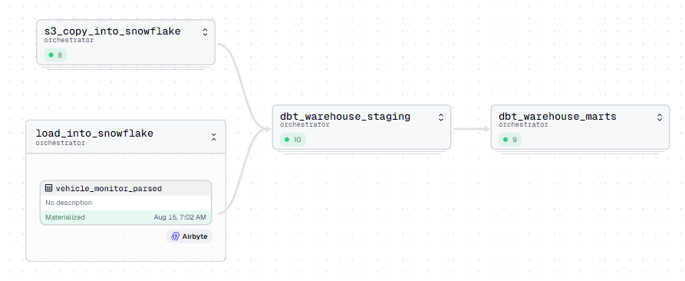
Orchestration - Asset job diagram
Notes:
Dagster was used for orchestration, deployed via Dagster Cloud. We considered Dagster Asset Job and Auto-materialize assets, choosing the former for its flexibility. Dagster handles Airbyte connections, Snowflake COPY INTO, and dbt workflows. Original Content: Orchestration Dagster was the orchestration tool used in this project and it was deployed using Dagster Cloud. Unlike other orchestration tools such as Airflow and Prefect, Dagster introduces an asset-based orchestration approach. As with many Data Engineering projects, there are many ways to orchestrate the data pipeline. More specifically, 3 different approaches were considered: 1. Dagster Asset Job: Create an Airbyte asset and a Databricks custom asset. These two assets would be selected to form an asset job that would be scheduled to run by Dagster 2. Dagster Auto-materialize assets: Create an Airbyte asset and a Databricks custom asset. Define and attach auto-materialize policies on these assets. Dagster will automatically materialize these assets when the specified criteria are met In this project, we use asset job to materialize the assets rather then Auto-materialize policy. We did it because it is a more flexible approach, allowing us to customize the execution logic and implement complex transformations steps that my not be possible with auto materialize. In this approach, Dagster is responsible for calling the Airbyte connection along with Snowflake COPY INTO and then the dbt workflow illustrated below. The Dagster Global Asset Lineage looks as follow: docs/images/dagster_asset_lineage.png Figure 6: Dagster Global Asset Lineage Asset job run on the cloud: docs/images/dagster_running_on_cloud.png Figure 7: Dagster asset job Scheduled runs: docs/images/dagster_runs.png Figure 8: Dagster asset job scheduled runs

Slide 14
Notes on Security
EC2 Instance Security Configuration
Expose only necessary ports: 22 (SSH), 443 (HTTPS), 8000, 8001 (Airbyte)
Whitelist only necessary IPs: your IP address and Dagster cloud IPs
RDS Instance Security Configuration
Whitelist only necessary IPs: your IP address and EC2 instance
Add EC2 security group as a source in RDS security group inbound rules
Notes:
When setting up your EC2 instance, expose only necessary ports and whitelist necessary IPs. For RDS instance, whitelist necessary IPs and add EC2 security group as a source in RDS security group inbound rules. Original Content: Notes on Security 1. When setting up your EC2 instance, be sure to configure your VPC security group to: – Expose only the necessary ports. Typically this is port 22 (for SSH), 443 (for HTTPS), and 8000 and 8001 for Airbyte – Whistelist only IPs that need to interact with your EC2 instance. This usually means your IP address and Dagster cloud IPs (if you use it as an orchestrator). You can check Dagster cloud IP addresses here 2. When setting up your RDS instance, be sure to configure your VPC security group to: – Whitelist only IPs that need to interact with your RDS instance. This usually means your IP address and EC2 instance (so that Airbyte can interact with your RDS instance). You can allow your EC2 instance to connect to your RDS instance by adding the EC2 security group as a source in the RDS security group inbound rules# debootcamp-busfleet

Slide 15
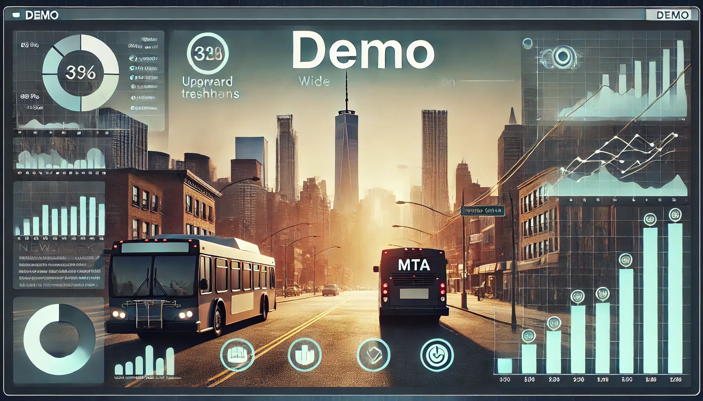
Notes:
This slide provides an overview of the project demo. It covers the scope and objectives of the project, as well as a summary of the key takeaways. The demo showcases the efficiency and scalability of the project pipeline, as well as its ability to answer key business questions using comprehensive data analysis. The use of cloud computing and data management technologies are critical to the project’s success and are highlighted in the accompanying images.

